Slide 1

Machine Vision CHC6781
Lecture 2:
Fundamental of Image Classification: A core task in computer vision
Module Leader: Dr Happy N. Monday
Contact via:
Email: happy.monday@zy.cdut.edu.cn
Office: Room 8102

Slide 2

Class Rules
Be on time
Bring your stuff (Pen, papers, folder, brain)
No pressing of phone, or gaming in the class.
Habit of Effective learners.
Prepare for your coursework and exam on time.
Always revise your PPTs before and after class.
Have Fun

Slide 3
Learning Outcomes
Understand the basic building block for more complex computer vision tasks
By the end of this topic, students should be able to grasp the process of image classification, the challenges it poses, and the various methods used for classification
This topic will introduce students to the concept of letting the data dictate the model's behavior, which is fundamental to modern machine learning.
Students will be prepared to tackle real-world scenarios where images might not conform perfectly to textbook definitions.

Slide 4
References
1. Richard Szeliski. (2017). Computer Vision: Algorithms and Applications. Springer
2. Géron, A. (2019). Hands-On Machine Learning with Scikit-Learn, Keras, and TensorFlow. O'Reilly Media.
3. Aggarwal, C.C. (2018). Neural Networks and Deep Learning. Springer
4. Goodfellow, I., Bengio, Y., & Courville, A. (2016). Deep Learning. MIT Press.
5. Hastie, T., Tibshirani, R., & Friedman, J. (2009). The Elements of Statistical Learning: Data Mining, Inference, and Prediction. Springer.
Gulli, A, Pal, S. (2017). Deep Learning with Keras. Packt Publishing
Montavon, G. Orr, G. Muller, K.K. (2012). Neural Networks: Tricks of the Trade. Springer.

Slide 5
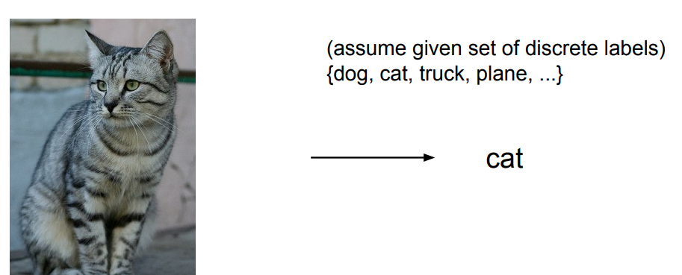
Image Classification
Image classification is a fundamental task in computer vision that involves assigning predefined categories or labels to images based on their visual content.

Slide 6
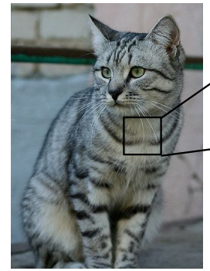
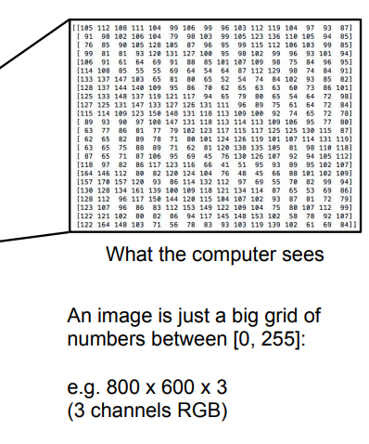
Problem: Semantic Gap
The semantic gap refers to the challenge of bridging the difference between low-level image features (pixels) and high-level semantic concepts (object categories).
It is difficult to directly map raw pixel values to meaningful object categories due to variations in appearance, viewpoint, lighting, and other factors.

Slide 7
Challenges in Image Classification
Viewpoint Variation
Illumination
Deformation
Occlusion
Background Clutter
Intraclass Variation

Slide 8
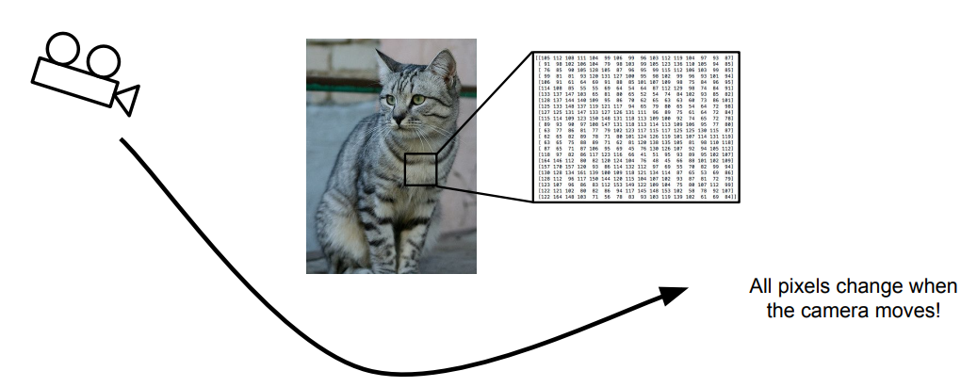
Challenges in Image Classification
Viewpoint Variation: Objects can appear different based on the viewpoint or angle from which they are observed.

Slide 9
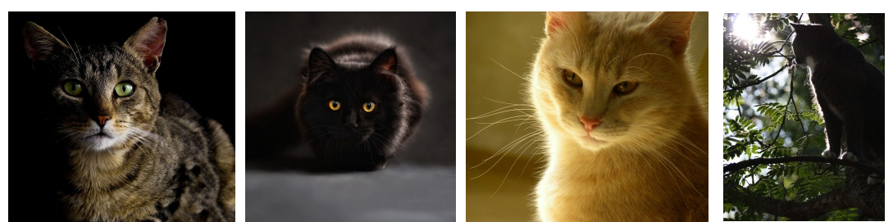
Challenges in Image Classification
Illumination: Lighting conditions can significantly affect the appearance of objects in images.

Slide 10
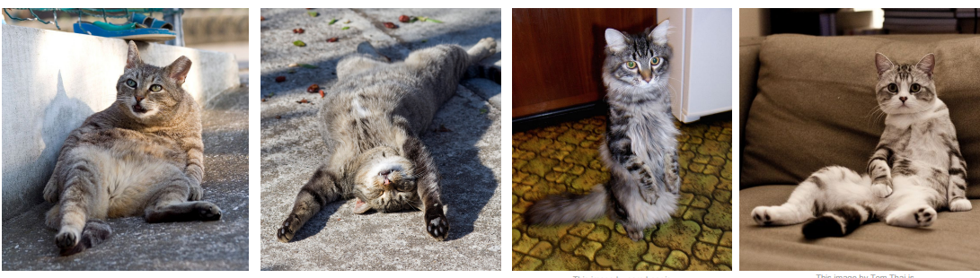
Challenges in Image Classification
Deformation: Objects can undergo deformations or distortions, making their shapes and structures vary.

Slide 11
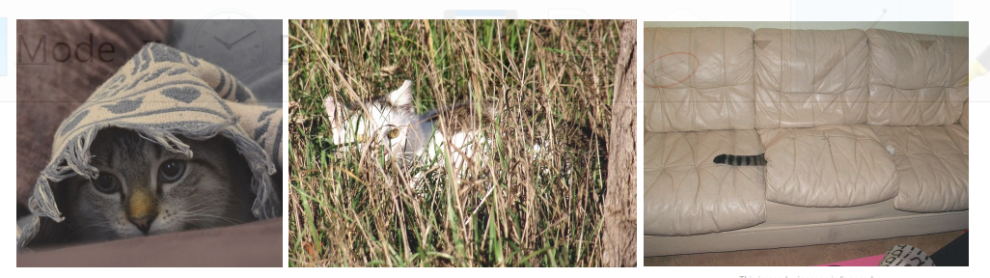
Challenges in Image Classification
Occlusion: Objects may be partially or fully occluded by other objects, making their identification challenging.

Slide 12
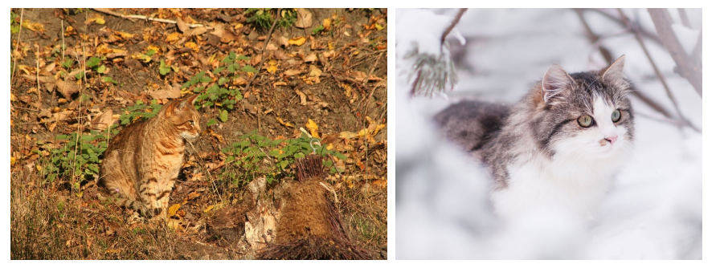
Challenges in Image Classification
Background Clutter: Complex backgrounds or cluttered scenes can make it harder to distinguish objects.

Slide 13
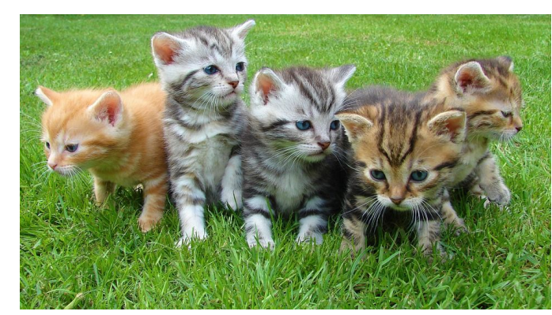
Challenges in Image Classification
Intraclass Variation: Objects within the same category can exhibit variations in shape, texture, color, or other visual attributes.

Slide 14
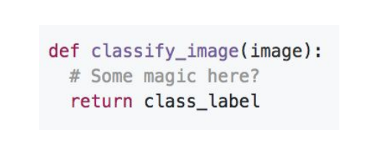
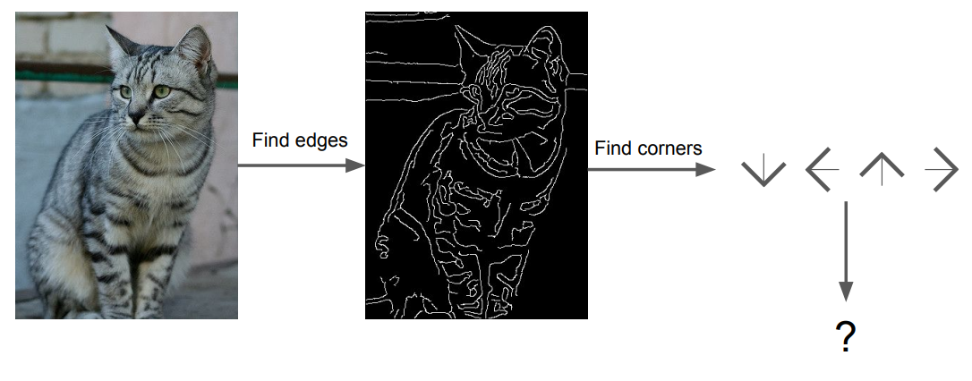
An Image Classifier
An image classifier is a computational model or algorithm that learns to classify images into predefined categories based on their visual features.
You can write a code to sort a list of numbers.
But there is no obvious way to hard-code the algorithm for recognizing a cat, or other objects.

Slide 15
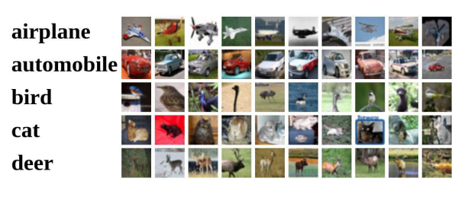
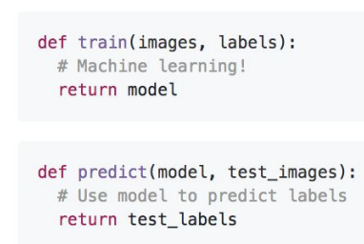
Data-driven Approach
In image classification, a data-driven approach involves collection of images and labels, use Machine Learning classifier to learn the mapping from image features to category labels directly from the training data, and evaluate the classifier on new images.
Example training set

Slide 16
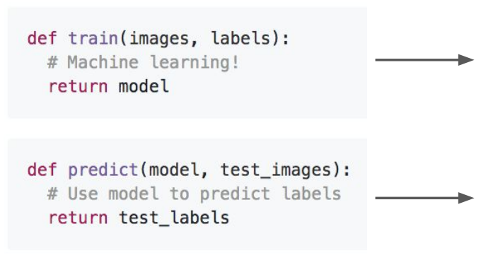
Nearest Neighbor Classifier
Nearest Neighbor (NN) is a simple and intuitive image classification algorithm.
It assigns the label of the nearest training image (neighbor) to the test image based on a similarity metric.
The distance between images is used as a measure of similarity.
Memorize all data and labels
Predict the label of the most similar training image.

Slide 17
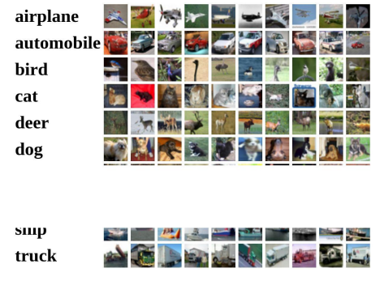
Data-driven Approach
Example Dataset: CIFAR 10
10 classes
50,000 training images
10, 000 testing images

Slide 18
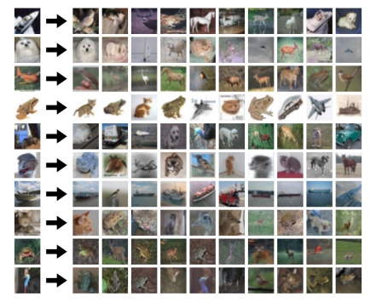
Data-driven Approach
Example Dataset: CIFAR 10
10 classes
50,000 training images
10, 000 testing images
test images and nearest neighbors

Slide 19
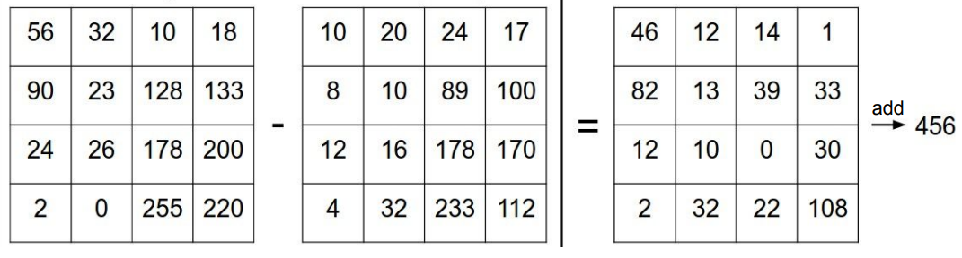
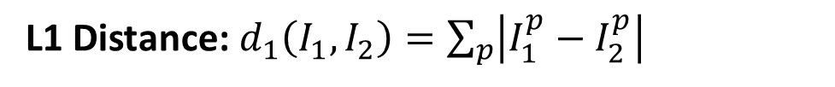
Distance Metric to Compare Images
A distance metric quantifies the similarity or dissimilarity between two images.
Commonly used distance metrics include Euclidean distance, Manhattan distance, and cosine similarity.
The choice of distance metric depends on the image representation and the characteristics of the data.
L1 Distance: $d_{1}\left(I_{1},I_{2}\right)=\sum_{p}{\left|I_{1}^{p}−I_{2}^{p}\right|}$
test image
training image
Pixel-wise absolute value difference

Slide 20
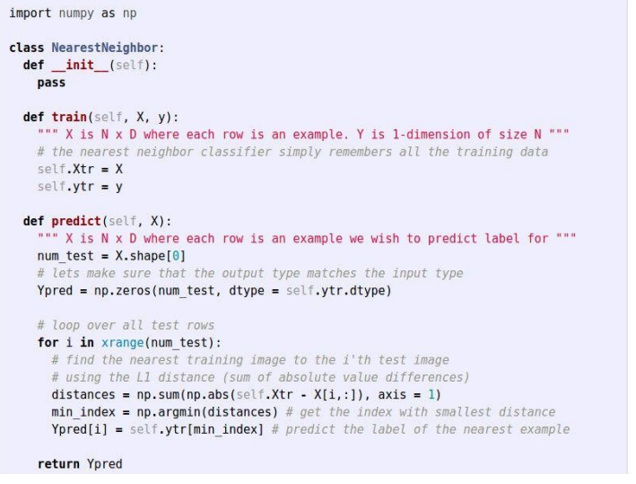
Nearest Neighbor Classifier

Slide 21
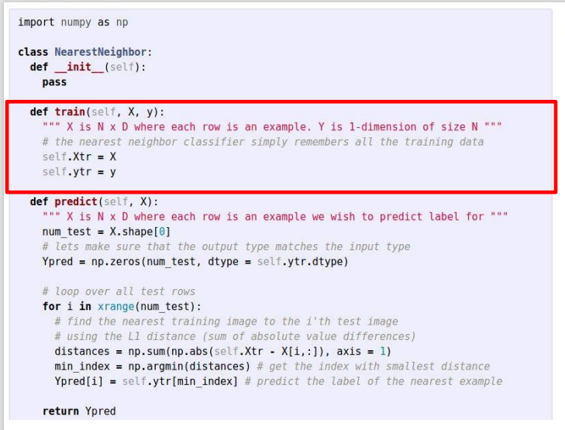
Nearest Neighbor Classifier
Memorize training data

Slide 22
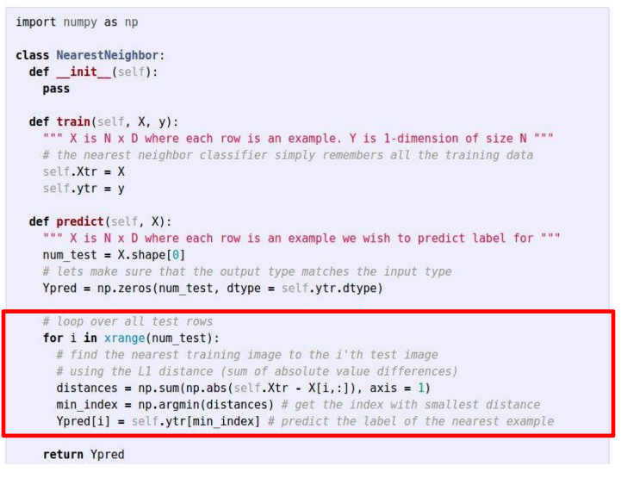
Nearest Neighbor Classifier
For each test image: Find closest train image and predict label of the nearest image

Slide 23
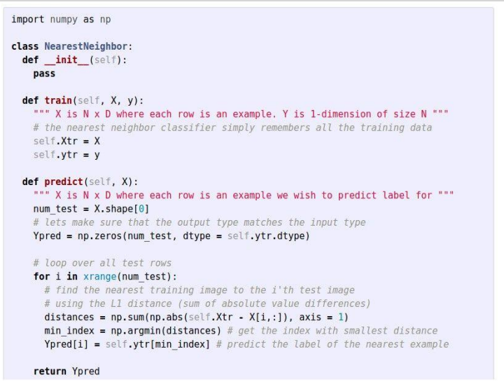
Nearest Neighbor Classifier
Q: With N examples, how fast are training and prediction?
Answer: This is bad: We want classifiers that are fast at prediction, slow at training is ok

Slide 24
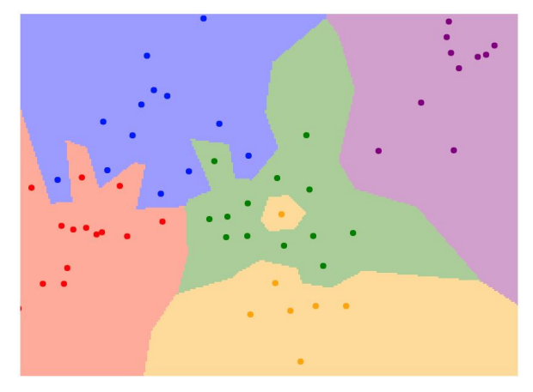
Nearest Neighbor Classifier
What does this look like?

Slide 25
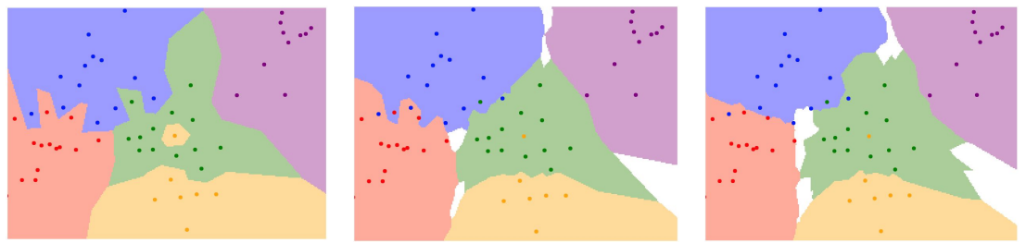
K-Nearest Neighbors
K-Nearest Neighbors (KNN) is an extension of the nearest neighbor algorithm.
Instead of considering only the nearest neighbor, KNN considers the labels of the K closest training examples and assigns the majority label to the test image.
K is a hyper-parameter that needs to be tuned for optimal performance.
Instead of copying label from nearest neighbor, take majority vote from K closest points
K=1
K=3
K=5

Slide 26
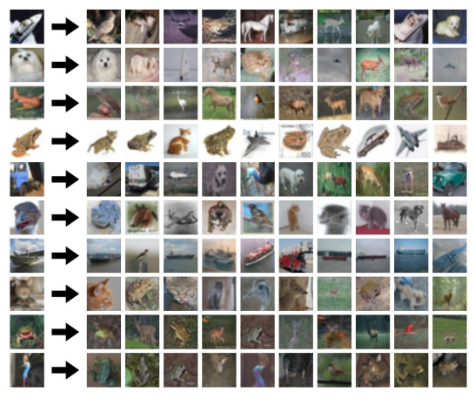
K-Nearest Neighbors
What does this look like

Slide 27
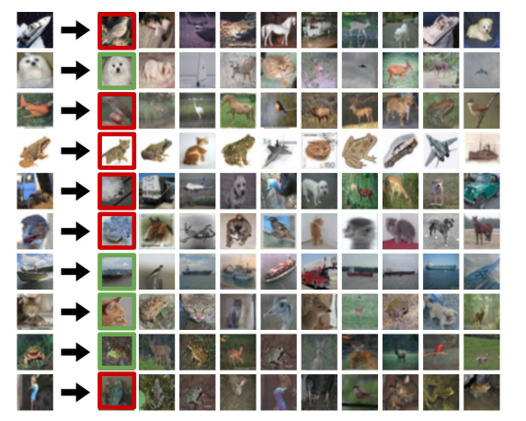
K-Nearest Neighbors
What does this look like

Slide 28

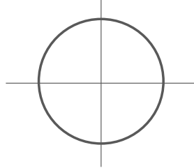
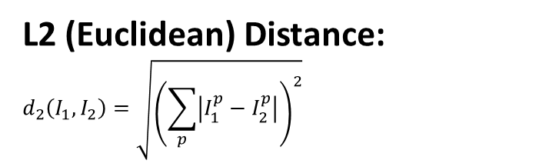
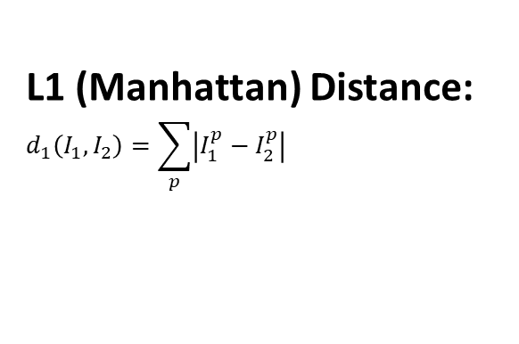
K-Nearest Neighbors: Distance Metric
A distance metric quantifies the similarity or dissimilarity between two images.
Commonly used distance metrics include Euclidean distance, Manhattan distance, and cosine similarity.
The choice of distance metric depends on the image representation and the characteristics of the data.
L1 (Manhattan) Distance:
$$d_{1}\left(I_{1},I_{2}\right)=\sum_{p}{\left|I_{1}^{p}−I_{2}^{p}\right|}$$
L2 (Euclidean) Distance:
$$d_{2}\left(I_{1},I_{2}\right)=\sqrt{{\left(\sum_{p}{\left|I_{1}^{p}−I_{2}^{p}\right|}\right)}^{2}}$$

Slide 29
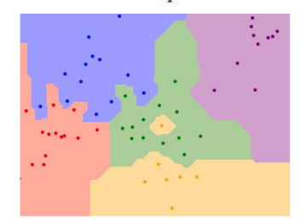
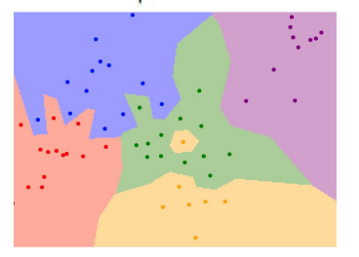
K-Nearest Neighbors: Distance Metric
A distance metric quantifies the similarity or dissimilarity between two images.
Commonly used distance metrics include Euclidean distance, Manhattan distance, and cosine similarity.
The choice of distance metric depends on the image representation and the characteristics of the data.
L1 (Manhattan) Distance:
$$d_{1}\left(I_{1},I_{2}\right)=\sum_{p}{\left|I_{1}^{p}−I_{2}^{p}\right|}$$
L2 (Euclidean) Distance:
$$d_{2}\left(I_{1},I_{2}\right)=\sqrt{{\left(\sum_{p}{\left|I_{1}^{p}−I_{2}^{p}\right|}\right)}^{2}}$$
K=1
K=1

Slide 30
Hyper-parameters:
Hyperparameters are parameters that are not learned from the data but need to be set before training the classifier.
In KNN, the value of K and the choice of distance metric are hyperparameters that can significantly affect the performance of the classifier.
Finding the best values for these hyperparameters often requires experimentation and validation.
What is the best value of K to use?
What is the best distance to use?

Slide 31
Hyper-parameters:
Hyperparameters are parameters that are not learned from the data but need to be set before training the classifier.
In KNN, the value of K and the choice of distance metric are hyperparameters that can significantly affect the performance of the classifier.
Finding the best values for these hyperparameters often requires experimentation and validation.
What is the best value of K to use?
What is the best distance to use?
This is considered problem-dependent.
You must try them all out and see what works best

Slide 32
Hyper-parameters Setting:
Try #1: Choose hyper-parameters that work best on the data
Your Dataset

Slide 33
Hyper-parameters Setting
Try #1: Choose hyper-parameters that work best on the data
Your Dataset
BAD: K=1 always works perfectly on training data

Slide 34
Hyper-parameters Setting
Try #1: Choose hyper-parameters that work best on the data
BAD: K=1 always works perfectly on training data
Your Dataset
Try #2: Split data into train and test, choose hyperparameter that work best on test data
Train
Test

Slide 35
Hyper-parameters Setting
Try #1: Choose hyper-parameters that work best on the data
BAD: K=1 always works perfectly on training data
Your Dataset
Try #2: Split data into train and test, choose hyper-parameter that work best on test data
BAD: No idea how algorithm will perform on new data
Train
Test

Slide 36
Hyper-parameters Setting
Try #1: Choose hyper-parameters that work best on the data
BAD: K=1 always works perfectly on training data
Your Dataset
BAD: No idea how algorithm will perform on new data
Try #2: Split data into train and test, choose hyper-parameter that work best on test data
Train
Test
Try #3: Split data into train, val, and test, choose hyper-parameter on val and evaluate, the test work best on test data
Better
Train
Test
Validation

Slide 37
K- Nearest Neighbor Summary
K-nearest neighbor on images is never used.
Very slow at test time
Distance metrics on pixels are not informative
In Image classification we start with a training set of images and labels, and must predict labels on the test set
The K-Nearest Neighbors classifier predicts labels based on nearest training examples
Distance metric and K are hyperparameters
Choose hyperparameters using the validation set; only run on the test set once at the very end!

Slide 38
Linear Classification
Linear classification is a machine learning technique used for classifying data into different categories based on linear decision boundaries. It assumes that the relationship between the input features and class labels can be represented by a linear function.
In a linear classifier, the goal is to find a hyperplane that best separates the data points belonging to different classes in the feature space.

Slide 39
Recall: CIFAR 10 Dataset
50,000 training images, each image is 32x32x3
10,000 test images

Slide 40
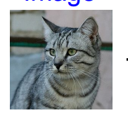
Parametric Approach
A parametric approach involves learning a set of parameters that define the linear decision boundary.
The parameters are estimated using training data and optimization techniques like gradient descent.
The learned parameters determine the weights assigned to different image features.
10 categories, giving the class score
f(x,W)
W
Array of 32x32x3 numbers (3072 numbers in total)
Parameters or weights

Slide 41
Parametric Approach: Linear Classifier
A parametric approach involves learning a set of parameters that define the linear decision boundary.
The parameters are estimated using training data and optimization techniques like gradient descent.
The learned parameters determine the weights assigned to different image features.
f(x,W) = Wx
10 categories, giving the class score
f(x,W)
W
Array of 32x32x3 numbers (3072 numbers in total)
Parameters or weights

Slide 42
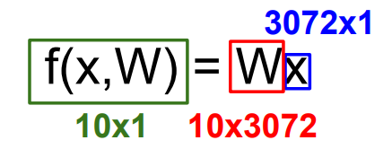
Parametric Approach: Linear Classifier
A parametric approach involves learning a set of parameters that define the linear decision boundary.
The parameters are estimated using training data and optimization techniques like gradient descent.
The learned parameters determine the weights assigned to different image features.
10 categories, giving the class score
f(x,W)
W
Array of 32x32x3 numbers (3072 numbers in total)
Parameters or weights

Slide 43
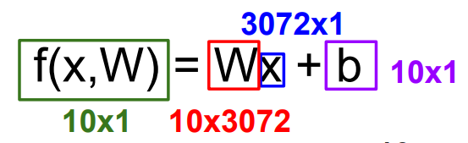
Parametric Approach: Linear Classifier
A parametric approach involves learning a set of parameters that define the linear decision boundary.
The parameters are estimated using training data and optimization techniques like gradient descent.
The learned parameters determine the weights assigned to different image features.
10 categories, giving the class score
f(x,W)
W
Array of 32x32x3 numbers (3072 numbers in total)
Parameters or weights

Slide 44
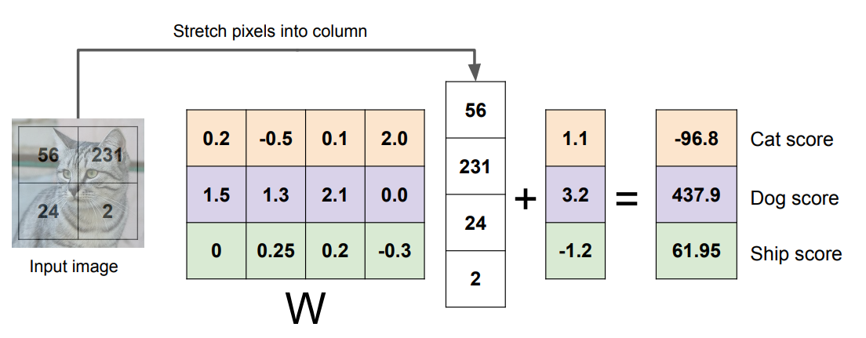
Parametric Approach: Linear Classifier
Example with an image with 4 pixels, and 3 classes (Cat/Dog/ship)

Slide 45
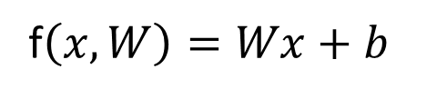
Interpreting a Linear Classifier
A linear classifier can provide insights into the importance of different features for classification.
Positive weights indicate features that positively contribute to a particular class, while negative weights indicate features that negatively contribute.
The magnitude of the weights represents the relative importance of the corresponding features.
f$\left(x,W\right)=Wx+b$
What is this thing doing?

Slide 46
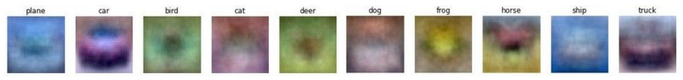
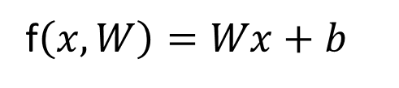
Interpreting a Linear Classifier
f$\left(x,W\right)=Wx+b$
Example trained weights of a linear classifier trained on CIFAR 10

Slide 47
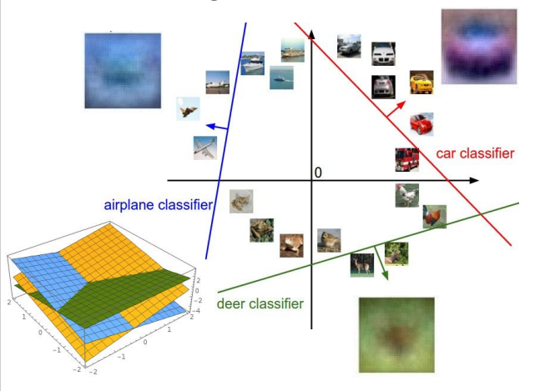
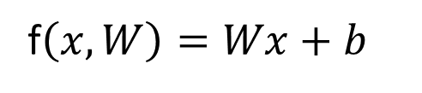
Interpreting a Linear Classifier
f$\left(x,W\right)=Wx+b$
Array of 32x32x3 numbers (3072 numbers in total)

Slide 48
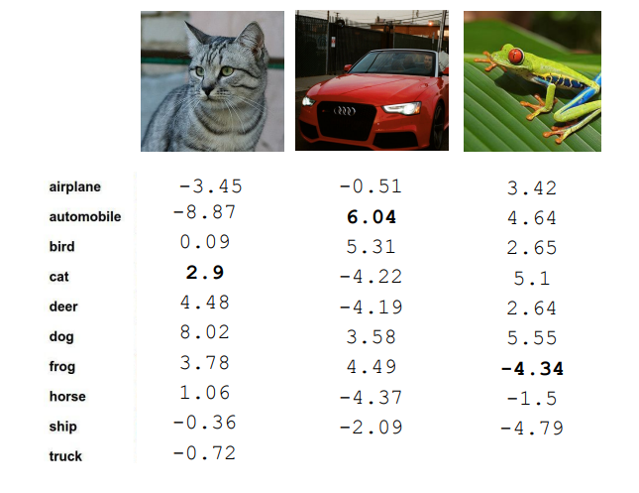
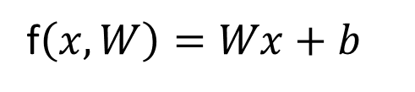
Linear Score Function
f$\left(x,W\right)=Wx+b$
The linear score function computes a weighted sum of image features and compares it to a threshold to make predictions. It is used to determine which side of the decision boundary an image falls on.
Example of class scores for 3 images for some W
How can we tell whether this W is good or bad?

Slide 49
Coming up:
f$\left(x,W\right)=Wx+b$
Quantifying what it means to have a good ‘W’
Loss function
Start with random ‘W’ and find a ‘W’ that minimizes the loss
Optimization
Tweak the functional form of ‘f’
ConvNets

Slide 50
The End!

